Slide 1
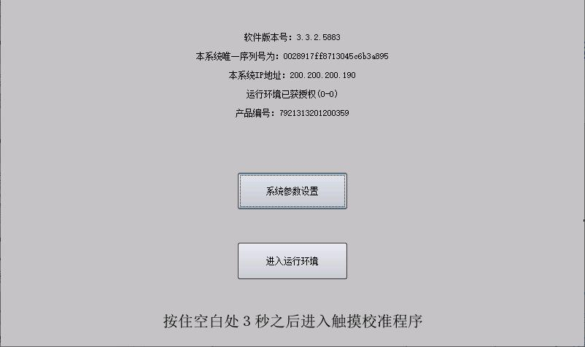
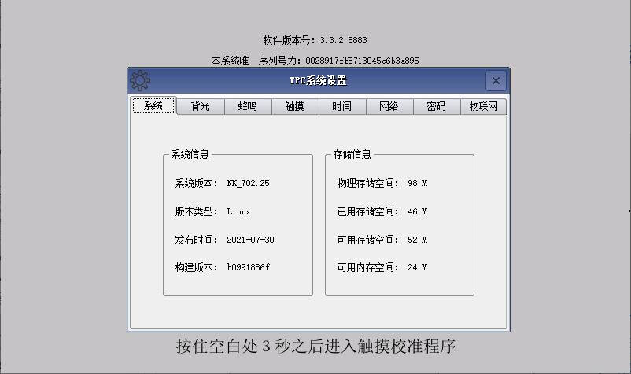
HMI Settings
1、WiFi Internet Settings
1, after the touch screen is powered on, continuously click the touch screen panel to enter the "start page configuration interface", click the "系统参数设置" button to enter the "TPC系统设置" interface;
Click系统参数设置

Slide 2
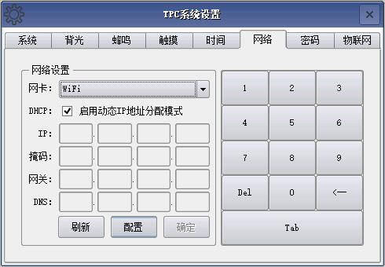
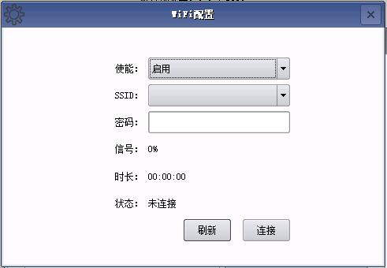
HMI Settings
1、WiFi Internet Settings
2. click the "网络" tab, select "WiFi" in the network card options, and then click "配置" to enter the "WiFi配置" window.
1.Select WiFi
2、Click配置

Slide 3
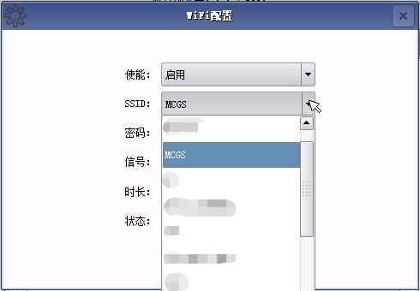
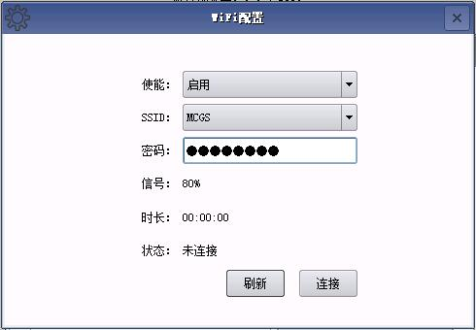
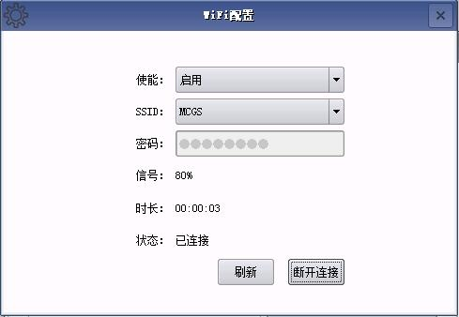
HMI Settings
1、WiFi Internet Settings
3、Select "启用" for "使能", click the SSID drop-down box, select the name of the wireless network you want to connect to, then enter the password（密码） and click "连接", after connecting successfully, the status will change from "未连接" to "已连接". After successful connection, the status will change from "Not connected" to "Connected", and then close the "WiFi 配置" window.
Change from "未连接" to "已连接"
1、Select启用
2、Select SSID
4、Click连接
3、Enter a password

Slide 4
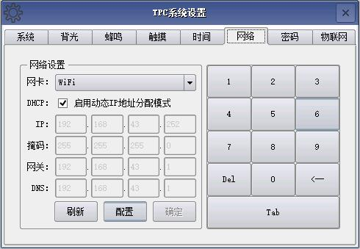
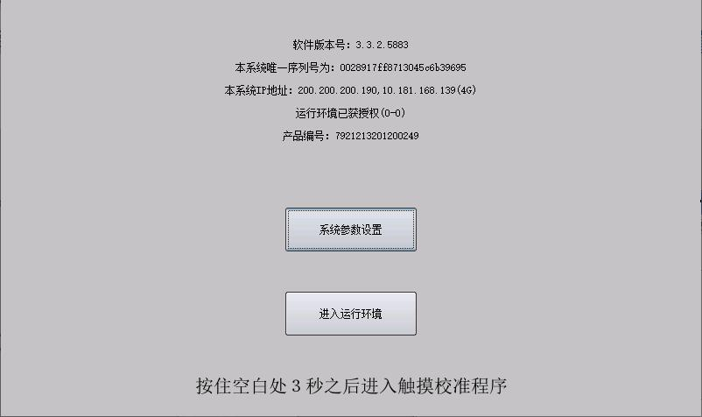
HMI Settings
1、WiFi Internet Settings
4、After the touch screen connects to WiFi successfully, you can see the current WiFi IP address of the screen in the "网络" setting interface, and in the "启动页面配置界面" interface, the WiFi IP address also appears to indicate that you can access the Internet;
WiFi IP address appears to indicate Internet access

Slide 5
Debugging Assistant
2. Installation instructions
1、PC installation instructions: PC installation, enter the package folder, directly run the "MCGS调试助手_V1.9.exe" application; after the installation is complete, generate a shortcut icon on the desktop MCGS调试助手.

Slide 6
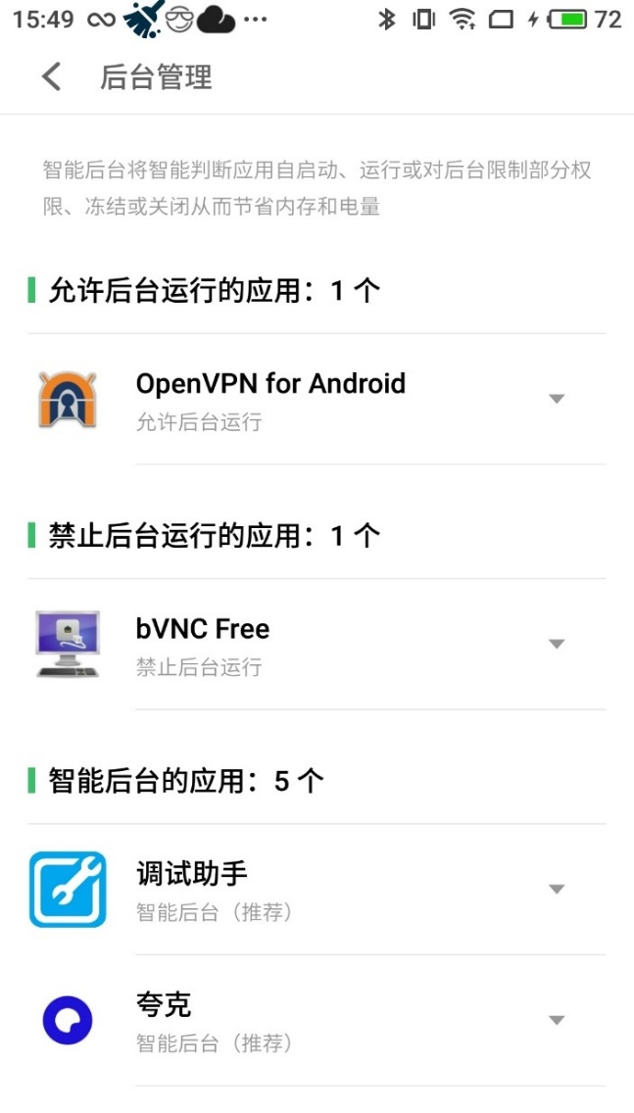
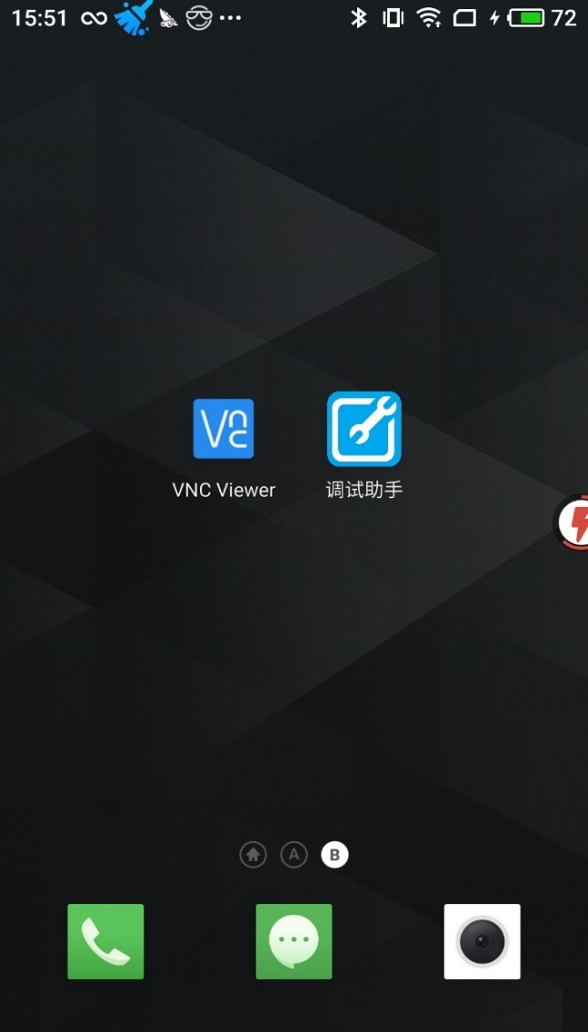
Debugging Assistant
二、安装说明
2、Installation instructions for cell phone: Installation on mobile phone, only Android users are supported for the time being. Send the APK file (Figure 1) that needs to be installed to your cell phone to install the application on your cell phone. After successful installation, three software will be installed on the phone: VNC Viewer, 调试助手 and OpenVPN for Android (the software will not be displayed on the interface of some phones.) Note: After the installation, you need to set the "OpenVPN for Android" software to be allowed to start and run in the background, and the "Debugging Assistant" software to run in the background. Please refer to the document "2021_技术部_手机关联启动VPN教程V1.0_0526.pptx" for the steps of allowing the associated startup.
Figure 1
Figure 2
Figure 3

